Slide 1
User modeling Changing machine decision
Present by Oz Shapira

Slide 2
User modeling In a Nutshell
User modeling ”is a sub-area of human–computer interaction, in which the researcher / designer develops cognitive models of human users, including modeling of their skills and declarative knowledge. User models can predict human error and learning time, and can thus serve as a cheaper alternative to user testing. User models can guide user interface designers to minimize error rates and learning time.”
Wikipedia
User modeling is used today in variant of application from standard user application to web-application(web personalization), e-learning application ,in the last year even games.

Slide 3
Introduction
For creating user modeling systems there is tree traditional way :
Creating dynamic data base with anthology which application “know” all user stereotype .
Creating Adapting application with some abilities of learning .
Combination of those two options (1 & 2).

Slide 4
Introduction – apdaption
In the resent years software application started to obtain user adapting abilities , applications and services change there action according to current user.
According to Alfred Kobsa User modeling research has spread into many disciplines which are concerned with the development of computer systems that are to be used by heterogeneous user populations. These fields include:
Human-Computer Interaction.
Intelligent Interfaces.
Adaptive Interfaces.
Cognitive Engineering.
Intelligent Information Retrieval.
Intelligent Tutoring .
Active and Passive Help Systems.
Guidance Systems .
Hypertext Systems and Expert Systems.

Slide 5
Introduction -Adaptation
In this lecture review will focus on the application adaptive part and ask if software can analyzing by itself user behavior.

Slide 6
Adaptation
The demand of software personalization have increase the developing of adaptive software.
Form Adaptive Hypermedia and Adaptive Web-Based Systems throw mainframe systems.
For creating adaptive software it must consist with the user knowledge and pursued for new data on is owner.

Slide 7
Adaptation – user knowledge
When user model developer his system it’s have to seek for user background knowledge.
According to Kobsa software have to fulfill tree task :
User subgroup identification.
Identification of key characteristics.
Representation in (hierarchically ordered) stereotypes

Slide 8
Adaption -throw User model
For indentifying User and to modeling it, the model must be robust for changes Carrapatoso & Vaz de Carvalho recommend to create DID (domain Independent data) & DDD (Domain Dependent Data) for each user .
The concept of DID and DDD (Benyon, 1993; Kobsa, 2001; Carrilho, 2004) have it’s advantage by admitting the needed of those two aspect for creating good UM.

Slide 9
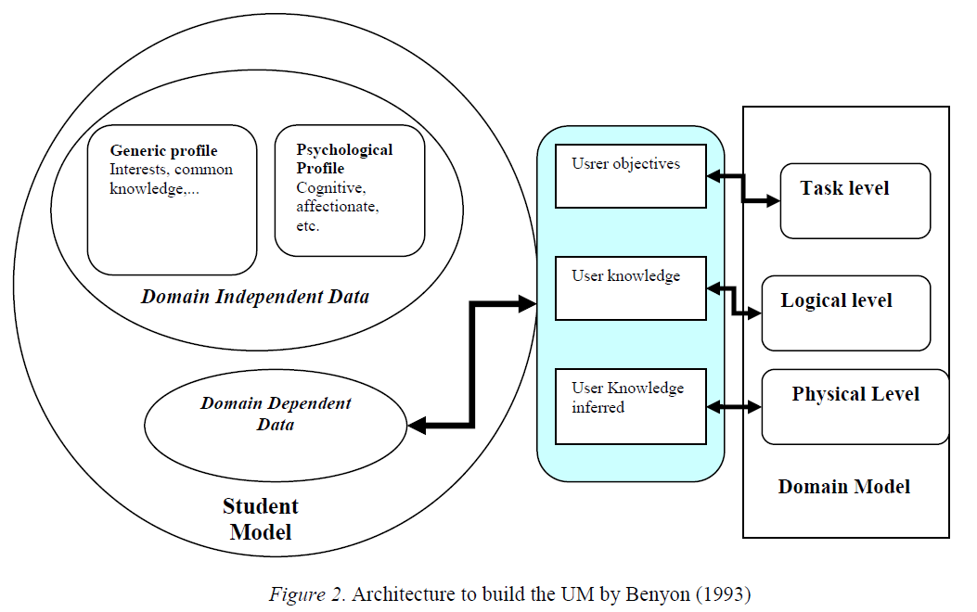
Adaption -throw User model
Example of that used :

Slide 10
Adaption - User plans & actions
For successfully adaption software need the ability to predict user action and plans
While the basic algorithm is fairly simple and straightforward, serious combinatorial problems arise when it is practically employed, due to the following reasons:
it is often unclear when the user commences a new plan.
actions and short action sequences may often be part of more than one plan.
From :User Modeling:Recent Work, Prospects and Hazards by alfred Kobsa

Slide 11
Adaption - User plans & actions
users may interrupt or suspend the execution of their current plans (for various reasons, such as when issuing the ‘date’ command or when replying to an email message which they just received);
there is often more than one action sequence for achieving a (sub-)goal (i.e., there can be variations of user plans).
From :User Modeling:Recent Work, Prospects and Hazards by alfred Kobsa

Slide 12
User Recognition
Two kinds of techniques are mainly employed for the recognition of users’ plans.
Plan libraries: In this approach, all possible user plans are already pre-stored in a socalled plan library (possibly, these plans contain open variables which have still to be instantiated). The observed user action sequence is compared with these pre-stored plans, and all plans are selected whose beginnings match the observed user input. In this approach, it is difficult to take the possibility of plan variations into account. All permissible deviations from a plan would have to be stored as separate plans.
From :User Modeling:Recent Work, Prospects and Hazards by alfred Kobsa

Slide 13
User Recognition
Plan construction: In this approach, the system possesses a library of all possible user actions, together with the effects and the preconditions of these actions. The observed user action sequence is completed by all possible user action sequences which fulfill the requirement that the effects of preceding actions meet the preconditions of subsequent actions.
From :User Modeling:Recent Work, Prospects and Hazards by alfred Kobsa

Slide 14
User Recognition & system reaction
For understand user plans the system need to recorded user action (creating observation).
The system also need strong and advance algorithm for analyze the observation.
By using some of Machine learning algorithm , we can predict the pattern of user action and plans.

Slide 15
Summarize & conclusion
Adaptive system are the key for user interaction .
The basic “process” of adaptive system is:
Obtain user knowledge
Model it In flexible way
Analyzing user request
respond
user observation

Slide 16
bibliography
User Modeling: Recent Work, Prospects and Hazards1 – alfred kobsa.
The User Modeling Shell System BGP-MS - Alfred Kobsa and Wolfgang Pohl
User Modeling in Adaptive Hypermedia Educational Systems - António Constantino Martins, Luíz Faria, Carlos Vaz de Carvalho, Eurico Carrapatoso
User Modeling in Adaptive Interfaces- Pat Langley

Slide 17
Adaptation
One of the aspect of user modeling is constructing learning machines application with the abilities to adapt the application according to user flavor.
In resent years application become more adaptive for users , from desktop application throw websites and smart phones software change there behavior and appearance according to the user request.

Slide 18
Question
Famous question: How to understand and Characterize user by very few data on him?
Understanding the main of human flavor ?
My question : how to combine user decision on real time building template handlers , in another word how the set new machine decision from new user Behavior

